Slide 1


Exposure Java 2013
APCS Edition
Chapter 4 Slides
Using Methods and Parameters
PowerPoint Presentation
created by:
Mr. John L. M. Schram
and Mr. Leon Schram
Authors of Exposure Java

Slide 2
Section 4.1
Introduction

Slide 3
Java vs. C++
Object Oriented Programming one of the main reasons we now teach Java instead of C++.
C++ was designed to be backwardly compatible with the original (non-OOP) C programming language. Therefore in C++, OOP is optional.
In Java OOP is required. The College Board wants students to learn OOP so Java it is.

Slide 4
Section 4.2
A Brief History of
Program Design

Slide 5
The 4 Stages of Program Design
• Cryptic Programming Stage
• Unstructured,
Spaghetti-Programming Stage
• Structured Programming Stage
• Object Oriented Programming Stage

Slide 6
Avoid Spaghetti Programming
Program Statement
Program Statement
Program Statement
Program Statement
Program Statement
Program Statement
Program Statement
Program Statement

Slide 7
Section 4.3
OOP, A Gentle
First Exposure

Slide 8
OOP
Object Oriented Programming (OOP) is a style of programming that incorporates these 3 features:
Encapsulation
Polymorphism
Class Interaction
Object Oriented Programming simulates real life by using a program style that treats a program as a group of objects.

Slide 9
OOP Example
A car could be an object in Java.
Objects have attributes and methods.
Car Attributes | Car Methods
Make & Model | Drive
Color | Park
# of Doors | Reverse
# of Seats | Tow
Nouns
Verbs

Slide 10

Encapsulation
Car Attributes | Car Methods
Make & Model | Drive
Color | Park
# of Doors | Reverse
# of Seats | Tow
Encapsulation means packaging or encapsulating all of the attributes and methods of an object in the same container.

Slide 11
Polymorphism
If we review our Algebra we should remember:
A monomial is a single term like: 3x
A binomial is 2 terms like: 3x + 7
A polynomial is many terms like: x² + 3x + 7
The prefix Poly means many.
Polymorphism means many forms.
Polymorphism is an advanced concept in computer science which will be discussed in chapter 14. To attempt to explain it now will only cause confusion.

Slide 12
Class Interaction - Inheritance
There are different types of Class Interaction. One type is Inheritance.
Suppose you wish to create Truck objects, Limo objects and Racecar objects. Instead of starting each from scratch we can use the existing Car in the following manner:
Inheritance will be discussed in Chapter 9.
A Truck is a Car with 4WD, big tires, and a bed.
A Limo is a very long luxury Car with many seats.
A Racecar is a Car with 1 seat, a very powerful engine, and a number painted on the side.

Slide 13
Section 4.4
Using the
Math Class

Slide 14
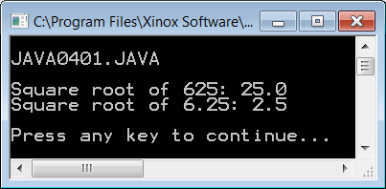
// Java0401.java
// This program shows how to use the <sqrt> method of the Math
// class. The Math class is part of the java.lang package, which is
// automatically loaded (imported) by the compiler.
// Math.sqrt returns the square root of the argument.
public class Java0401
{
public static void main (String args[])
{
System.out.println("\nJAVA0401.JAVA\n");
int n1 = 625;
double n2 = 6.25;
System.out.println("Square root of " + n1 + ": " + Math.sqrt(n1));
System.out.println("Square root of " + n2 + ": " + Math.sqrt(n2));
System.out.println();
}
}

Slide 15
// Java0401.java
// This program shows how to use the <sqrt> method of the Math
// class. The Math class is part of the java.lang package, which is
// automatically loaded (imported) by the compiler.
// Math.sqrt returns the square root of the argument.
public class Java0401
{
public static void main (String args[])
{
System.out.println("\nJAVA0401.JAVA\n");
int n1 = -625;
double n2 = 6.25;
System.out.println("Square root of " + n1 + ": " + Math.sqrt(n1));
System.out.println("Square root of " + n2 + ": " + Math.sqrt(n2));
System.out.println();
}
}
Try This!
Change the value of n1 from 625 to -625.
Recompile and execute and see what happens.

Slide 16
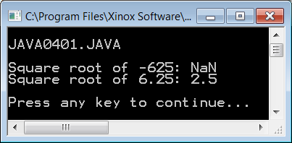
// Java0401.java
// This program shows how to use the <sqrt> method of the Math
// class. The Math class is part of the java.lang package, which is
// automatically loaded (imported) by the compiler.
// Math.sqrt returns the square root of the argument.
public class Java0401
{
public static void main (String args[])
{
System.out.println("\nJAVA0401.JAVA\n");
int n1 = -625;
double n2 = 6.25;
System.out.println("Square root of " + n1 + ": " + Math.sqrt(n1));
System.out.println("Square root of " + n2 + ": " + Math.sqrt(n2));
System.out.println();
}
}
NOTE: NaN means “Not A Number”.
Remember the square root of a
negative number is not a real number.

Slide 17
Class Method Syntax
Math.sqrt(n1)
1. Math is the class identifier,
which contains the methods you call.
2. • separates the class identifier from the
method identifier
3. sqrt is the method identifier
4. (n1) n1 is the argument or parameter passed
to the method

Slide 18
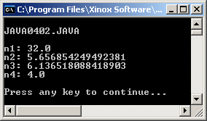
// Java0402.java
// This program shows different arguments that can be used with the <sqrt>
// method. Note how a method call can be the argument of another method call.
public class Java0402
{
public static void main (String args[])
{
System.out.println("\nJAVA0402.JAVA\n");
double n1, n2, n3, n4;
n1 = Math.sqrt(1024); // constant argument
n2 = Math.sqrt(n1); // variable argument
n3 = Math.sqrt(n1 + n2); // expression argument
n4 = Math.sqrt(Math.sqrt(256)); // method argument
System.out.println("n1: " + n1);
System.out.println("n2: " + n2);
System.out.println("n3: " + n3);
System.out.println("n4: " + n4);
System.out.println();
}
}

Slide 19
Method Arguments or Parameters
The information, which is passed to a method is called an
argument or a parameter.
Parameters are placed between parentheses immediately following the method identifier.
Parameters can be constants, variables, expressions or they can be methods.
The only requirement is that the correct data type value is passed to the method. In other words, Math.sqrt(x) can compute the square root of x, if x stores any non-negative number (int or double), but not if x stores a String value like "aardvark".

Slide 20
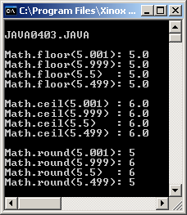
// Java0403.java
// This program demonstrates the <floor> <ceil> and <round> methods.
// The <floor> method returns the truncation down to the next lower integer.
// The <ceil> method returns the next higher integer.
// The <round> method rounds the argument and returns the closest integer.
public class Java0403
{
public static void main (String args[])
{
System.out.println("\nJAVA0403.JAVA\n");
System.out.println("Math.floor(5.001): " + Math.floor(5.001));
System.out.println("Math.floor(5.999): " + Math.floor(5.999));
System.out.println("Math.floor(5.5) : " + Math.floor(5.5));
System.out.println("Math.floor(5.499): " + Math.floor(5.499));
System.out.println();
System.out.println("Math.ceil(5.001) : " + Math.ceil(5.001));
System.out.println("Math.ceil(5.999) : " + Math.ceil(5.999));
System.out.println("Math.ceil(5.5) : " + Math.ceil(5.5));
System.out.println("Math.ceil(5.499) : " + Math.ceil(5.499));
System.out.println();
System.out.println("Math.round(5.001): " + Math.round(5.001));
System.out.println("Math.round(5.999): " + Math.round(5.999));
System.out.println("Math.round(5.5) : " + Math.round(5.5));
System.out.println("Math.round(5.499): " + Math.round(5.499));
System.out.println();
}
}

Slide 21
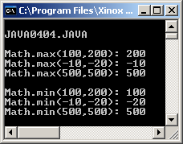
// Java0404.java
// This program demonstrates the <max> and <min> methods.
// Math.max returns the largest value of the two arguments.
// Math.min returns the smallest value of the two arguments.
public class Java0404
{
public static void main (String args[])
{
System.out.println("\nJAVA0404.JAVA\n");
System.out.println("Math.max(100,200): " + Math.max(100,200));
System.out.println("Math.max(-10,-20): " + Math.max(-10,-20));
System.out.println("Math.max(500,500): " + Math.max(500,500));
System.out.println();
System.out.println("Math.min(100,200): " + Math.min(100,200));
System.out.println("Math.min(-10,-20): " + Math.min(-10,-20));
System.out.println("Math.min(500,500): " + Math.min(500,500));
System.out.println();
}
}

Slide 22
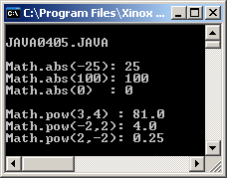
// Java0405.java
// This program demonstrates the <abs> and <pow> methods.
// Math.abs returns the absolute value of the argument.
// Math.pow returns the first argument raised to the power
// of the second argument.
public class Java0405
{
public static void main (String args[])
{
System.out.println("\nJAVA0405.JAVA\n");
System.out.println("Math.abs(-25): " + Math.abs(-25));
System.out.println("Math.abs(100): " + Math.abs(100));
System.out.println("Math.abs(0) : " + Math.abs(0));
System.out.println();
System.out.println("Math.pow(3,4) : " + Math.pow(3,4));
System.out.println("Math.pow(-2,2): " + Math.pow(-2,2));
System.out.println("Math.pow(2,-2): " + Math.pow(2,-2));
System.out.println();
}
}

Slide 23
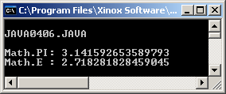
// Java0406.java
// This program demonstrates the <PI> and <E> fields of the
// Math class.
// Both <PI> and <E> are "final" attributes of the <Math> class.
// <PI> and <E> are not methods. Note there are no parentheses.
public class Java0406
{
public static void main (String args[])
{
System.out.println("\nJAVA0406.JAVA\n");
System.out.println("Math.PI: " + Math.PI);
System.out.println("Math.E : " + Math.E);
System.out.println();
}
}

Slide 24
AP Exam Alert
The Math class has many methods.
Only the abs, pow, sqrt and random methods will be tested on the
AP Computer Science Examination.
You will learn about
Math.random()
in chapter 6.

Slide 25
Section 4.5
Using
Graphics
Methods

Slide 26
Learning Graphics Programming
Learning graphics programming is not simply a fun issue.
You will learn many sophisticated computer science concepts by studying graphics programs.
Some of the most sophisticated programs are video games.
Only very dedicated and knowledgeable programmers can write effective video games.

Slide 27
Graphics & Coordinate Geometry
A graphics window uses a system of (X,Y) coordinates in a manner similar to the use of coordinates that you first learned in your math classes.
The next slide shows an example of the Cartesian Coordinate System.
In particular, note that the Cartesian system has four quadrants with the (0,0) coordinate located in the center of the grid where the X-Axis and the Y-Axis intersect.

Slide 28
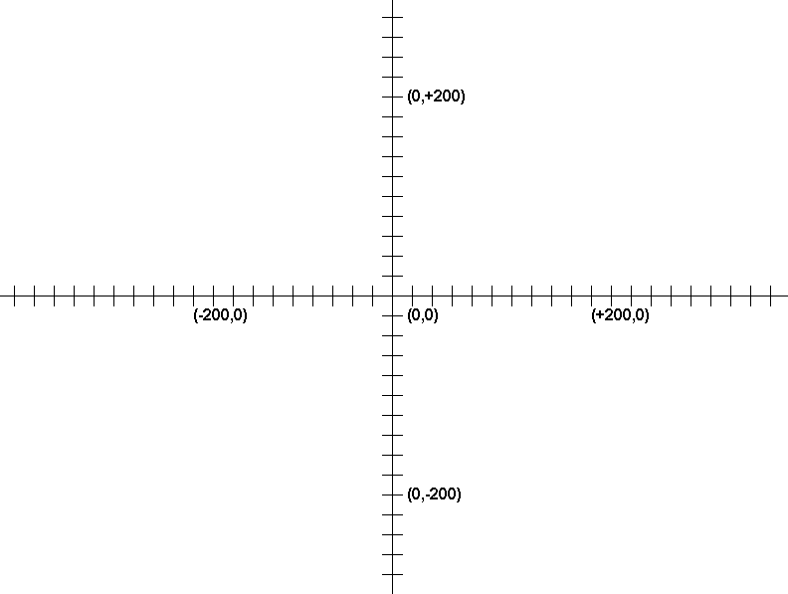
Cartesian Coordinate Graph

Slide 29
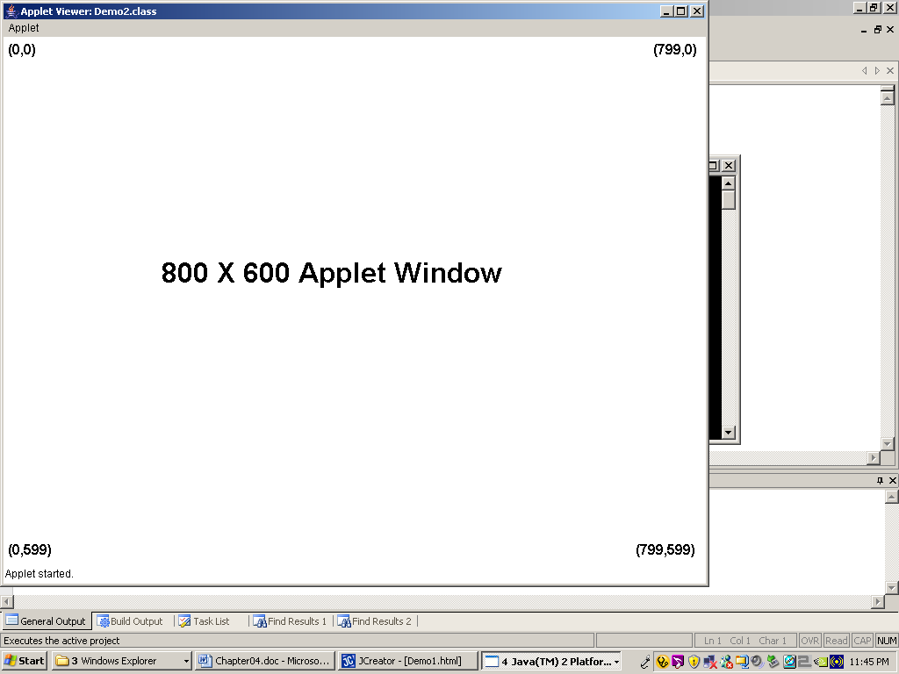

Slide 30
Executing Java Applet Programs
All the graphics programs examples that follow in this section are created as Java applets.
Make sure that you remember to compile the Java source code file, and then switch to some small web page file for execution.
It is possible to create the same exact displays with Java applications.

Slide 31
The drawLine Method
drawLine(int x1, int y1, int x2, int y2)
Draws a line from coordinate (x1,y1) to coordinate (x2,y2)
x1, y1
x2, y2

Slide 32
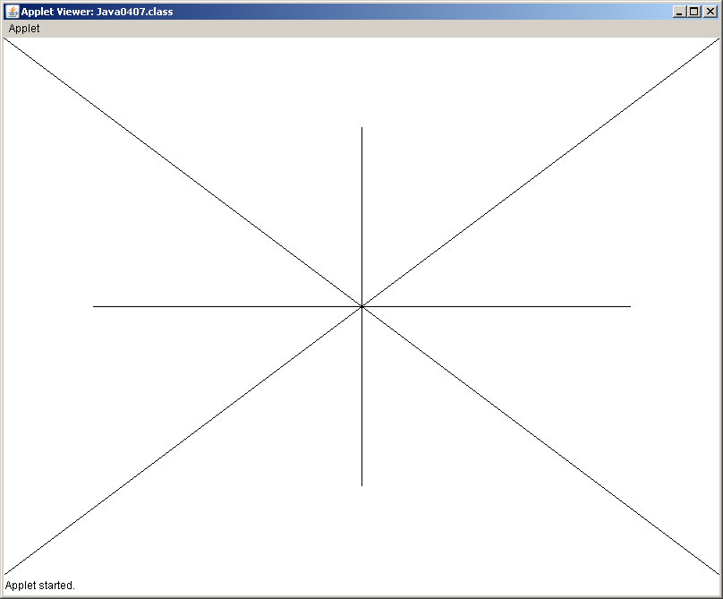
// Java0407.java
// This program demonstrates how to draw lines.
// Lines are drawn from (X1,Y1) to (X2,Y2) with drawLine(X1,Y1,X2,Y2).
import java.awt.*;
import java.applet.*;
public class Java0407 extends Applet
{
public void paint(Graphics g)
{
g.drawLine(0,0,800,600);
g.drawLine(0,600,800,0);
g.drawLine(100,300,700,300);
g.drawLine(400,100,400,500);
}
}
<!-- Java0407.html -->
<APPLET CODE = "Java0407.class" WIDTH=800 HEIGHT=600>
</APPLET>

Slide 33
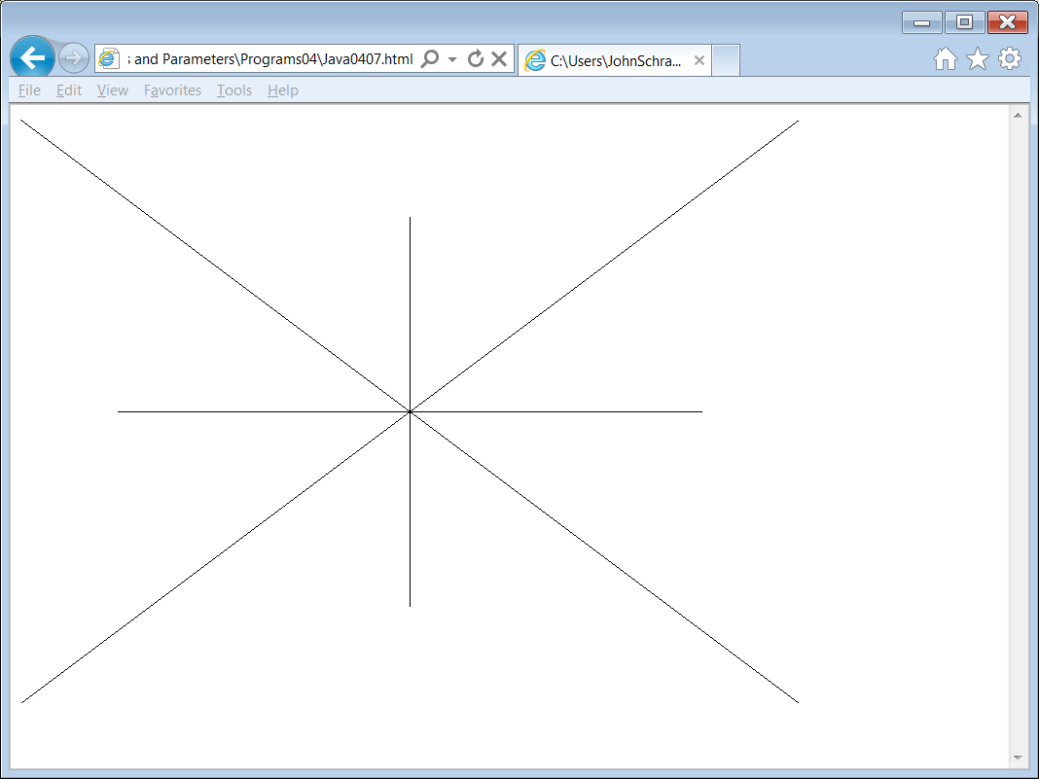
Java0407
in
Internet
Explorer

Slide 34
The drawRect Method
drawRect(int x, int y, int width, int height)
Draws a rectangle with top-left corner at coordinate (x,y) using width and height dimensions.
fillRect uses identical parameters, but fills in the rectangle.
x, y
height
width

Slide 35
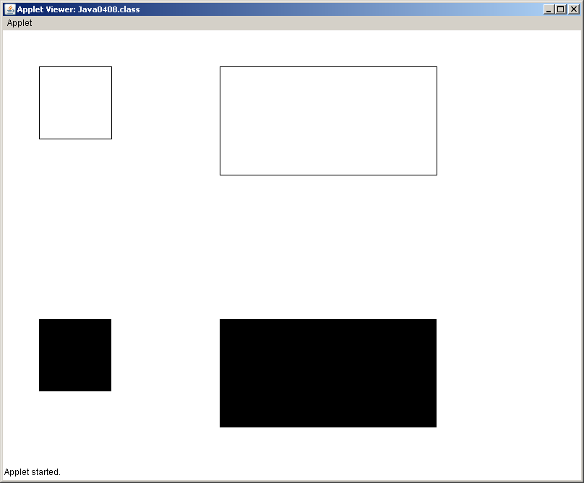
// Java0408.java
// This program introduces the rectangle command. A rectangle is drawn from
// the top-left (X,Y) coordinate of a rectangle followed by Width and Height using
// <drawRect(X,Y,Width,Height)>.
// The <fillRect> command draws a rectangle filled with solid pixels.
import java.awt.*;
import java.applet.*;
public class Java0408 extends Applet
{
public void paint(Graphics g)
{
g.drawRect(50,50,100,100);
g.drawRect(300,50,300,150);
g.fillRect(50,400,100,100);
g.fillRect(300,400,300,150);
}
}
<!-- Java0408.html -->
<APPLET CODE = "Java0408.class" WIDTH=800 HEIGHT=600>
</APPLET>

Slide 36
The drawOval Method
drawOval(int x, int y, int width, int height)
Draws an oval that is circumscribed by the rectangle with top-left corner at coordinate (x,y) using width and height dimensions.
fillOval uses identical parameters, but fills in the oval.
x, y
height
width

Slide 37
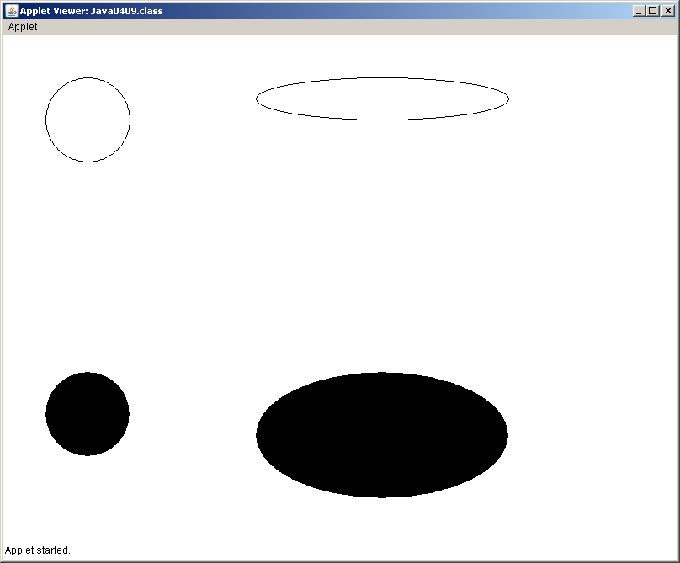
// Java0409.java
// This program uses the <drawOval> method to draw ovals and circles.
// The four parameters of the <drawOval> method are identical to the parameters
// of the <drawRect> method. With <drawOval(X,Y,Width,Height)> (X,Y) is the
// coordinate of the top-left corner of the rectangle that circumscribes the oval.
// It also shows that the Graphics variable does not have to be "g".
import java.awt.*;
import java.applet.*;
public class Java0409 extends Applet
{
public void paint(Graphics screen)
{
screen.drawOval(50,50,100,100);
screen.drawOval(300,50,300,50);
screen.fillOval(50,400,100,100);
screen.fillOval(300,400,300,150);
}
}
<!-- Java0409.html -->
<APPLET CODE = "Java0409.class" WIDTH=800 HEIGHT=600>
</APPLET>

Slide 38
The drawArc Method
drawArc(int x, int y, int width, int height, int start, int degrees)
Draws part of an oval. The 1st 4 parameters are the same as drawOval.
Start indicates the degree location of the beginning of the arc.
Degrees indicates the number of degrees traveled by the arc. 0 degrees is at the 3:00 o’clock position and increases counter clockwise to 360 degrees.
fillArc uses identical parameters, but “fills” in the arc.
x, y
90
180
height
0, 360
270
width

Slide 39
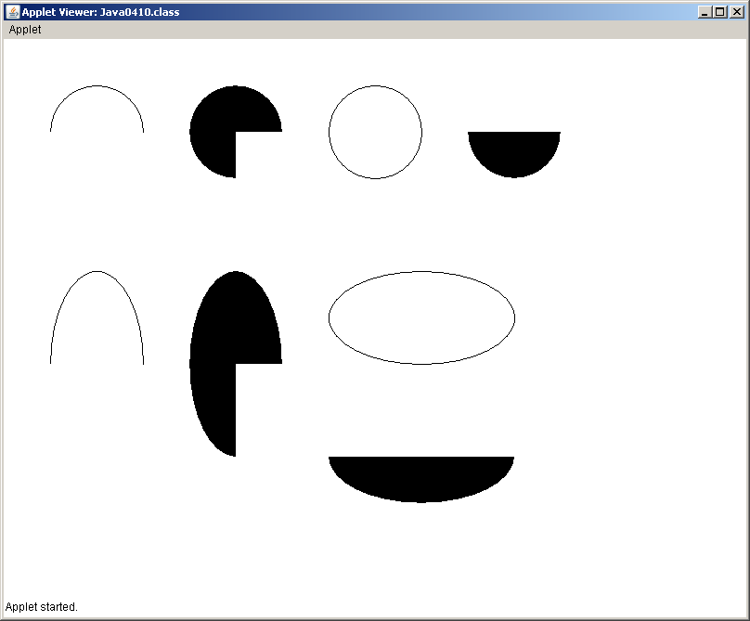
// Java0410.java
// This program uses the <drawArc> and <fillArcs> methods.
// Method <drawArc(X,Y,Width,Height,Start,Degrees)> uses the first four
// parameters in the same manner as the <drawOval> method. Start is the
// degree value of the arc-start and Degrees is the number of degrees the arc travels.
// Start (0 degrees) is at 3:00 o'clock and positive degrees travel counter-clockwise.
import java.awt.*;
import java.applet.*;
public class Java0410 extends Applet
{
public void paint(Graphics g)
{
g.drawArc(50,50,100,100,0,180);
g.fillArc(200,50,100,100,0,270);
g.drawArc(350,50,100,100,0,360);
g.fillArc(500,50,100,100,0,-180);
g.drawArc(50,250,100,200,0,180);
g.fillArc(200,250,100,200,0,270);
g.drawArc(350,250,200,100,0,360);
g.fillArc(350,400,200,100,0,-180);
}
}
<!-- Java0410.html -->
<APPLET CODE = "Java0410.class" WIDTH=800 HEIGHT=600>
</APPLET>

Slide 40
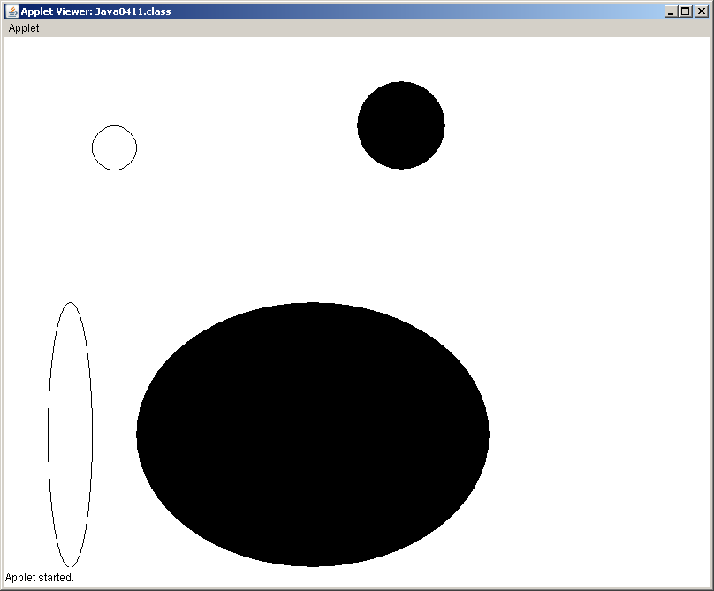
// Java0411.java
// This program demonstrates the significance of using parameters in the
// correct sequence Java0411.java is very similar to Java0409.java with
// rearranged parameters.
import java.awt.*;
import java.applet.*;
public class Java0411 extends Applet
{
public void paint(Graphics screen)
{
screen.drawOval(100,100,50,50);
screen.drawOval(50,300,50,300);
screen.fillOval(400,50,100,100);
screen.fillOval(150,300,400,300);
}
}
<!-- Java0411.html -->
<APPLET CODE = "Java0411.class" WIDTH=800 HEIGHT=600>
</APPLET>

Slide 41
Parameter Sequence Matters Java0409.java vs. Java0411.java
screen.drawOval(50,50,100,100);
screen.drawOval(300,50,300,50);
screen.fillOval(50,400,100,100);
screen.fillOval(300,400,300,150);
screen.drawOval(100,100,50,50);
screen.drawOval(50,300,50,300);
screen.fillOval(400,50,100,100);
screen.fillOval(150,300,400,300);

Slide 42
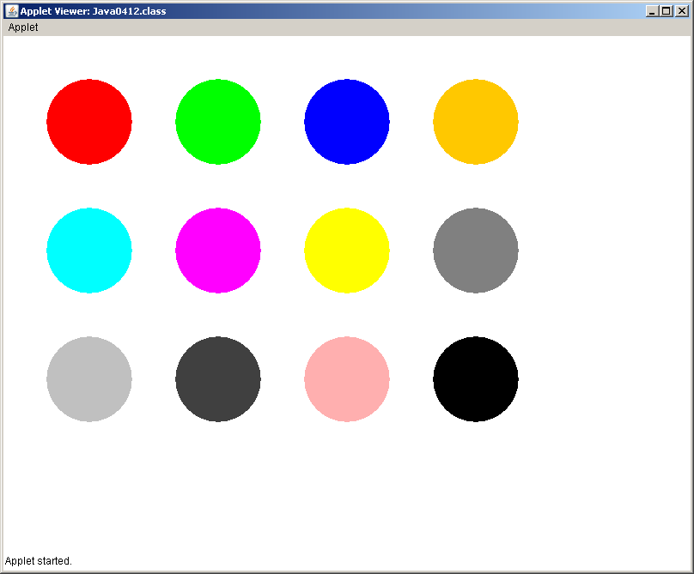
// Java0412.java
// This program demonstrates how to control the output display color with
// the <Color> class and the <setColor> method.
import java.awt.*;
import java.applet.*;
public class Java0412 extends Applet
{
public void paint(Graphics g)
{
g.setColor(Color.red); g.fillOval(50,50,100,100);
g.setColor(Color.green); g.fillOval(200,50,100,100);
g.setColor(Color.blue); g.fillOval(350,50,100,100);
g.setColor(Color.orange); g.fillOval(500,50,100,100);
g.setColor(Color.cyan); g.fillOval(50,200,100,100);
g.setColor(Color.magenta); g.fillOval(200,200,100,100);
g.setColor(Color.yellow); g.fillOval(350,200,100,100);
g.setColor(Color.gray); g.fillOval(500,200,100,100);
g.setColor(Color.lightGray); g.fillOval(50,350,100,100);
g.setColor(Color.darkGray); g.fillOval(200,350,100,100);
g.setColor(Color.pink); g.fillOval(350,350,100,100);
g.setColor(Color.black); g.fillOval(500,350,100,100);
}
}
<!-- Java0412.html -->
<APPLET CODE = "Java0412.class" WIDTH=800 HEIGHT=600>
</APPLET>

Slide 43
The setColor Method
setColor(Color.constant) Sets the graphics display color of the following graphics output to the specified constant of the Color class. There are 13 color constants listed below.
red green blue orange cyan magenta yellow gray lightGray drakGray pink black white
NOTE: You are not limited to only these 13 colors. By combining different amounts of red, green, and blue values you can create any of over 16 million different colors. You will be shown how to do this in a later chapter.

Slide 44
// Java0413.java
// This program demonstrates the <drawString> method.
// With <drawString("Hello World",x,y)>, the string Hello World
// will be displayed starting at the [x,y] pixel coordinate.
import java.awt.*;
import java.applet.*;
public class Java0413 extends Applet
{
public void paint(Graphics g)
{
g.drawString("This string will display in default black at coordinate [200,250]",
200,250);
g.setColor(Color.red);
g.drawString("This string will display in red at coordinate [5,50]",5,50);
g.setColor(Color.blue);
g.drawString("This string will display in blue at coordinate [400,500]",400,500);
}
}
<!-- Java0413.html -->
<APPLET CODE = "Java0413.class" WIDTH=800 HEIGHT=600>
</APPLET>

Slide 45
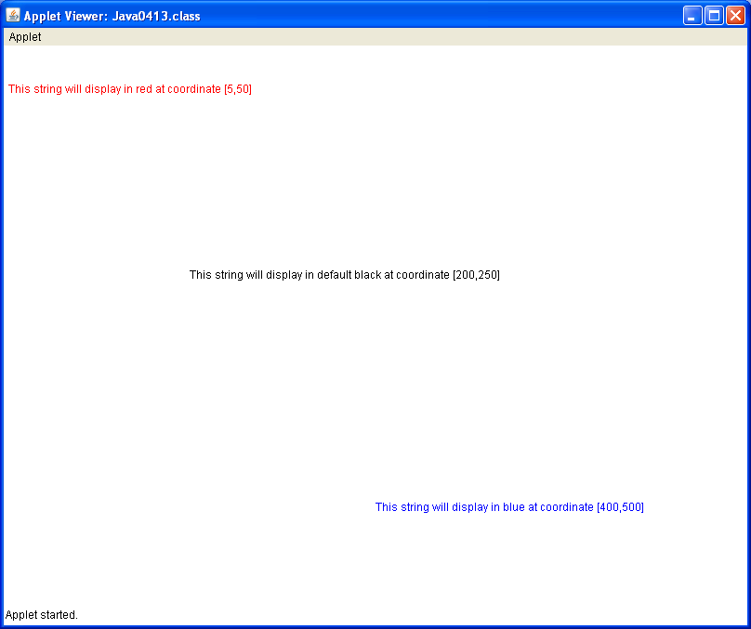

Slide 46
The drawString Method
drawString(String s, int x, int y)
Draws a String s starting at the at coordinate (x,y).
Hello there!
x, y

Slide 47

PreAP and AP Graphics Alert
If you used the Expo class in a PreAP Computer Science course, be aware that you will strictly use Java commands that are part of Java standard libraries.
Using the Expo class
was like riding a bike
with training wheels.
Now that you are in
AP Computer Science,
the time has come to remove those training wheels.

Slide 48
Section 4.6
Observing the
GridWorld Start

Slide 49
GridWorld Alert
All the previous graphics programs in this chapter were written as applets.
You were required to compile the java program and then switch to the web page file ending in .html to execute the applet program.
The GridWorld programs are also graphics programs, but they are meant to be executed as application programs and you will notice that there is a main method.

Slide 50
4 GridWorld Executions
The next couple slides will show 4 different executions of GridWorld.
Pay close attention to what is the same in each execution and what is different.

Slide 51
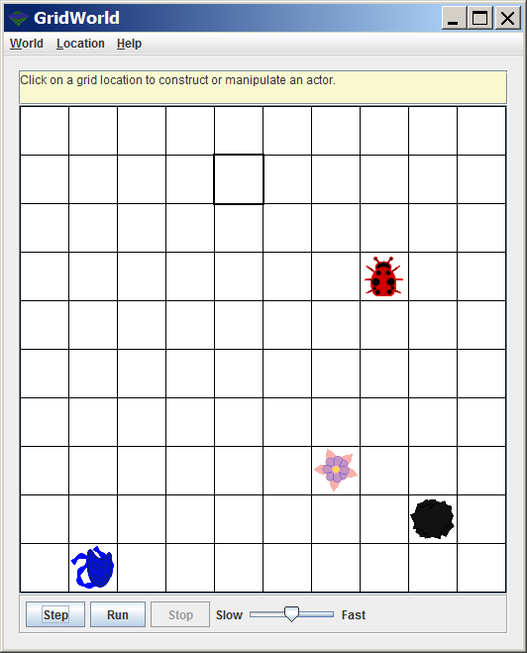
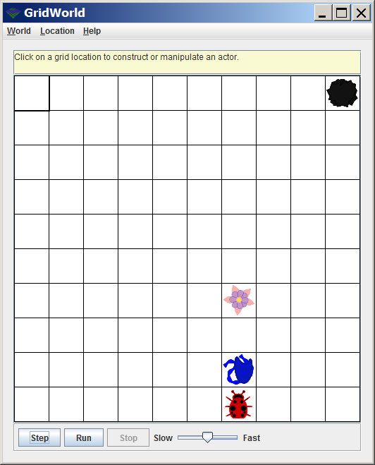
Executions 1 & 2

Slide 52
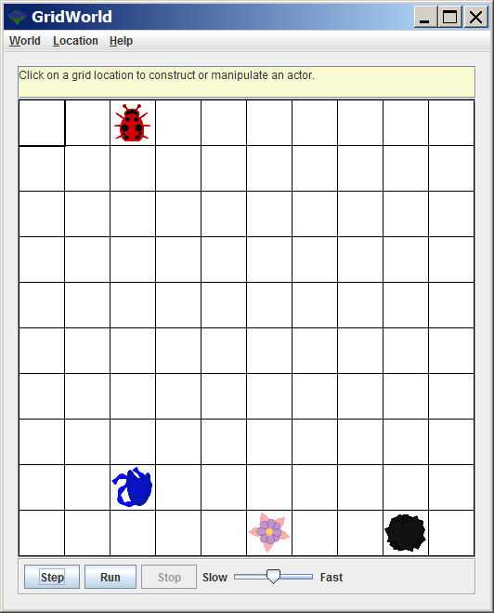
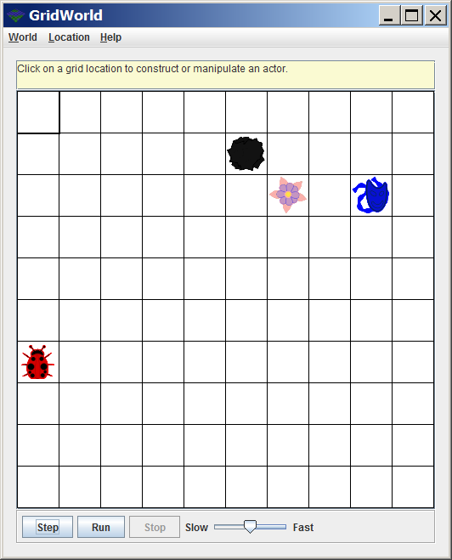
Executions 3 & 4

Slide 53
Section 4.7
Examining the
Grid Environment

Slide 54
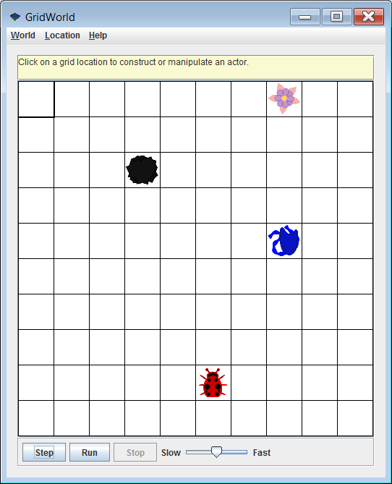
Changing the Dimensions of a Bounded Grid – 1
By default, you have a Bounded Grid with 10 rows
and 10 columns.

Slide 55
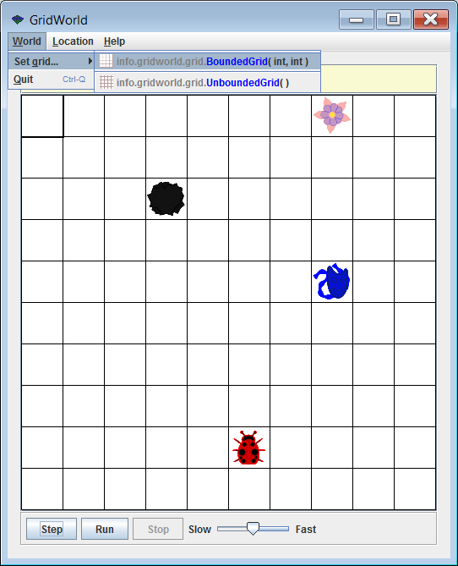
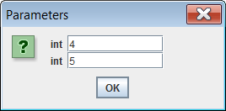
Changing the Dimensions of a Bounded Grid – 2

Slide 56
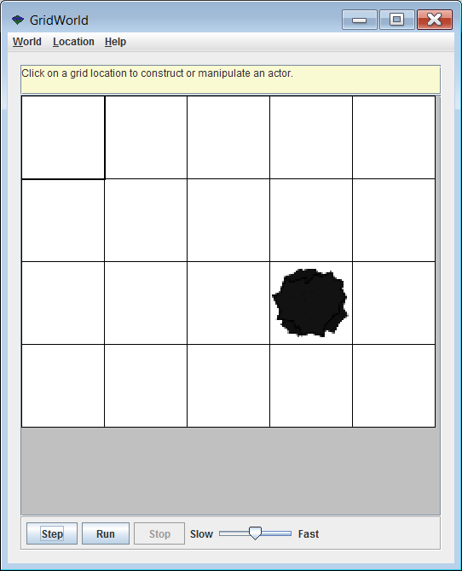
Changing the Dimensions of a Bounded Grid – 3
Where did the other 3 objects go?
If you change back to a 10 by 10 grid, will the other 3 objects show up?

Slide 57
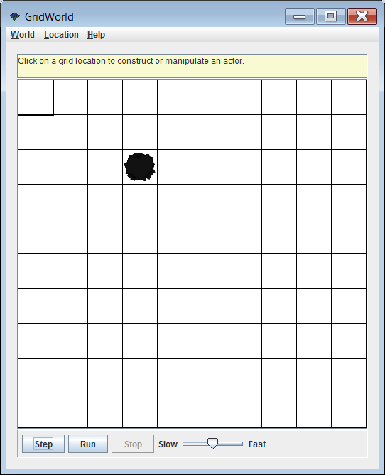
Changing the Dimensions of a Bounded Grid – 4

Slide 58
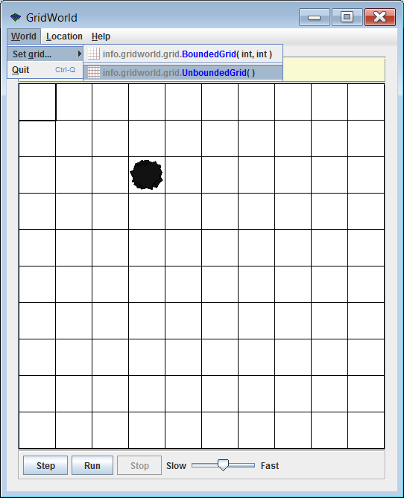
Changing to an Unbounded Grid – 1

Slide 59
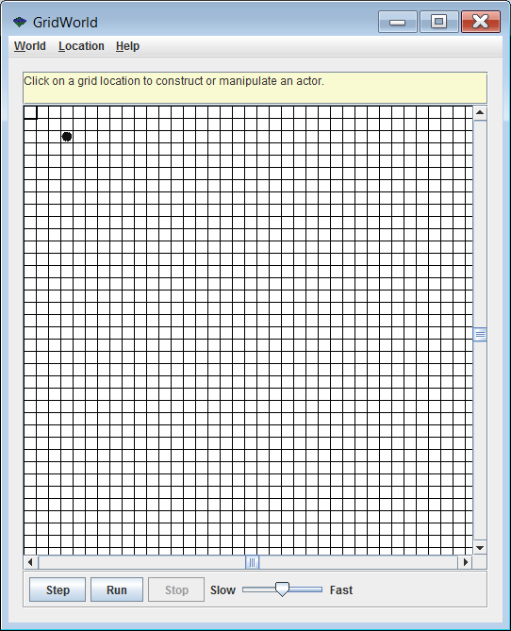
Changing to an Unbounded Grid – 2
You now essentially have infinite rows and infinite columns.
If you use the scroll bars you will find that it is impossible to scroll to the top or bottom because this grid never ends.

Slide 60
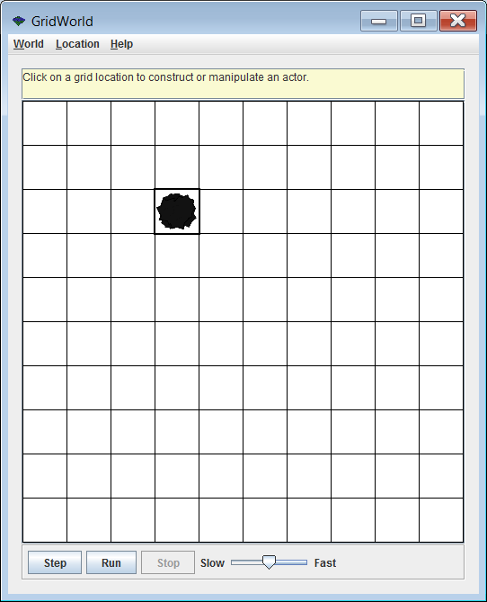
Changing the Location
of the Highlighted Cell – 1
We have returned to
a Bounded Grid with 10 rows
and 10 columns.
Note that the cell with the rock is highlighted.

Slide 61
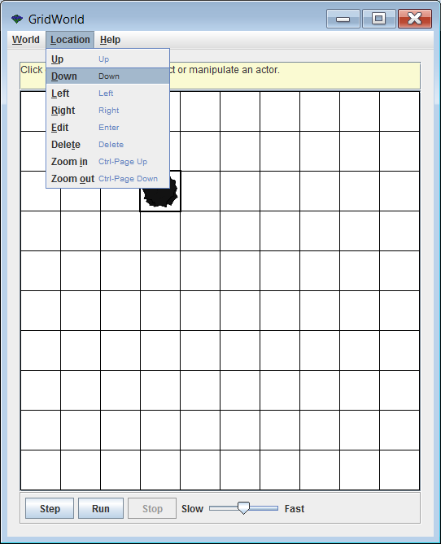
Changing the Location
of the Highlighted Cell – 2

Slide 62
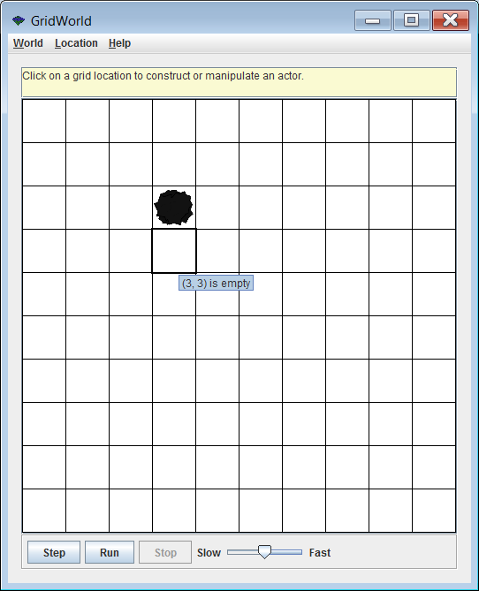
Changing the Location
of the Highlighted Cell – 3
Now the highlighted cell has moved down to row 3 column 3.
Note:
The top-left corner is row 0 column 0.

Slide 63
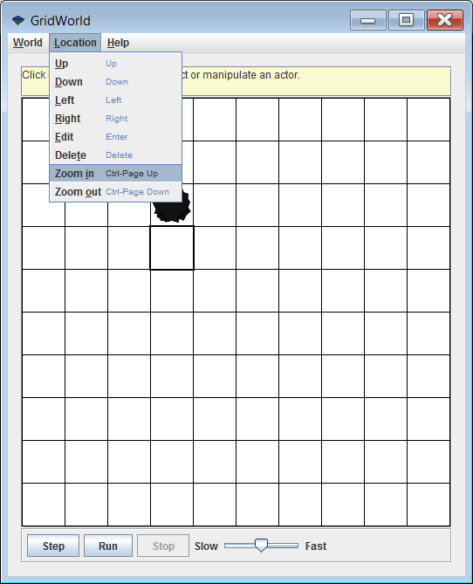
Location Menu
Zooming In – 1

Slide 64
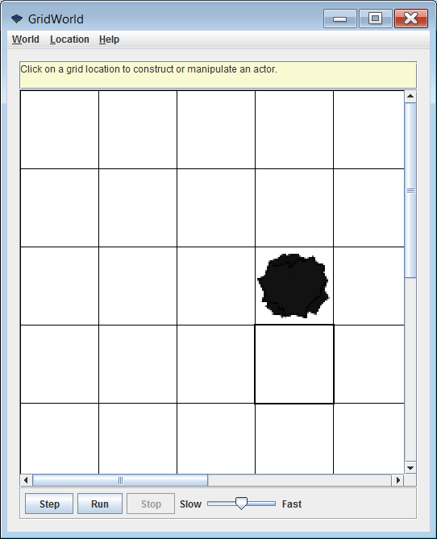
Location Menu
Zooming In – 2
It may look like we just resized the grid to
5 rows and 5 columns,
but notice the scroll bars. The other rows and columns still exist.

Slide 65
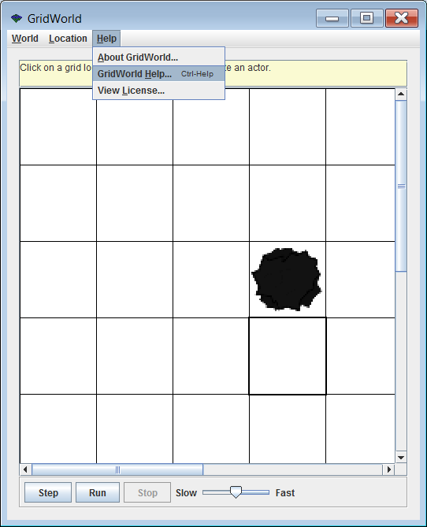
GridWorld Help – 1

Slide 66
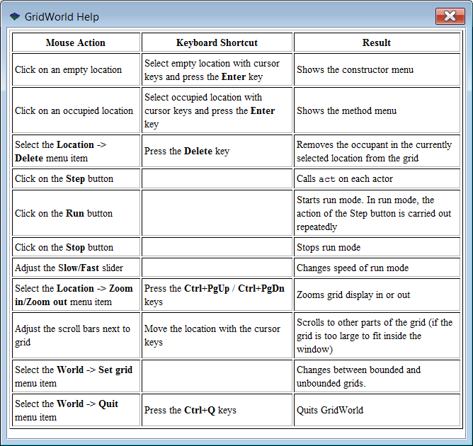
GridWorld Help – 2

Slide 67
Section 4.8
GridWorld Objects
Behavior

Slide 68
6 Steps
To understand how different objects behave, the next 6 slides will show a sequence of 6 consecutive Steps.

Slide 69
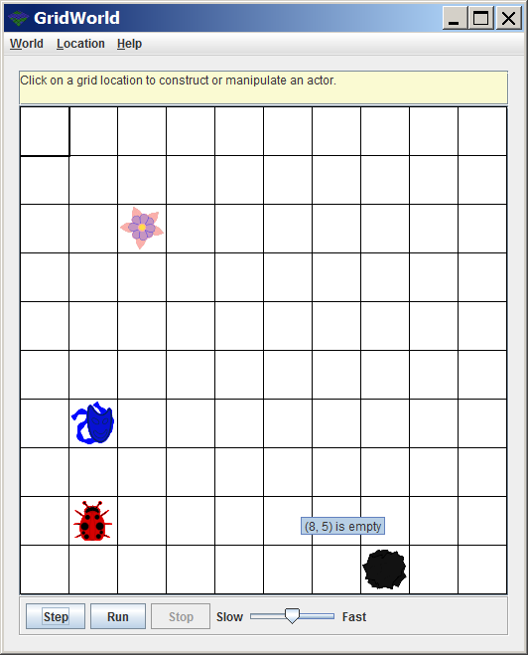
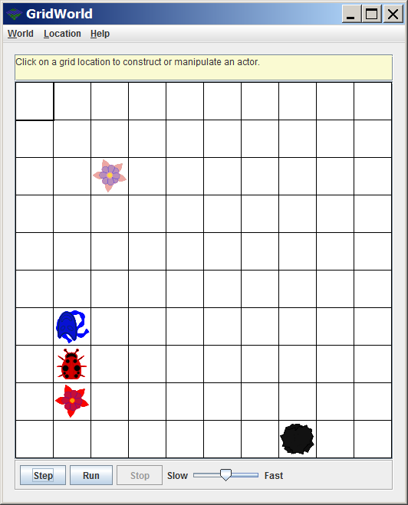
Steps 1 & 2

Slide 70
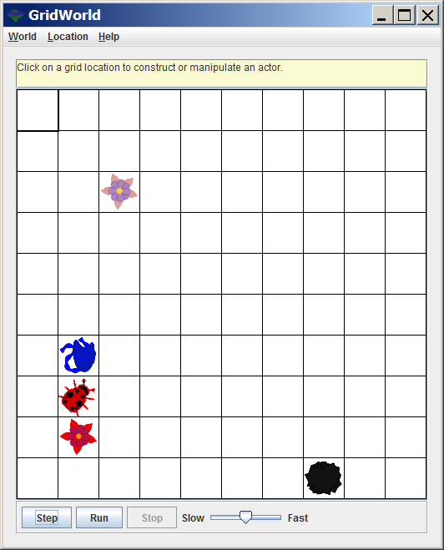
Steps 2 & 3

Slide 71
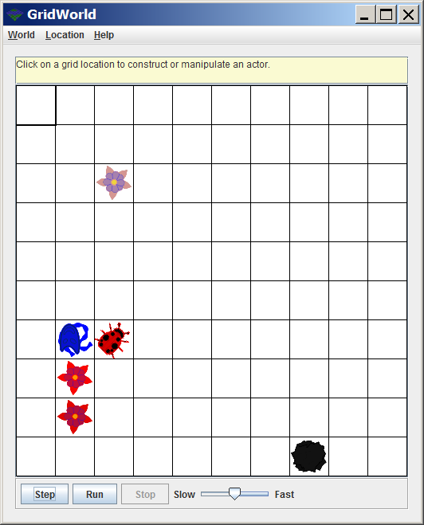
Steps 3 & 4

Slide 72
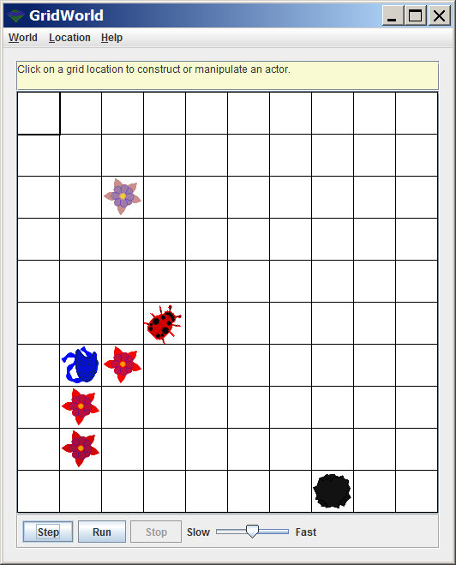
Steps 4 & 5

Slide 73
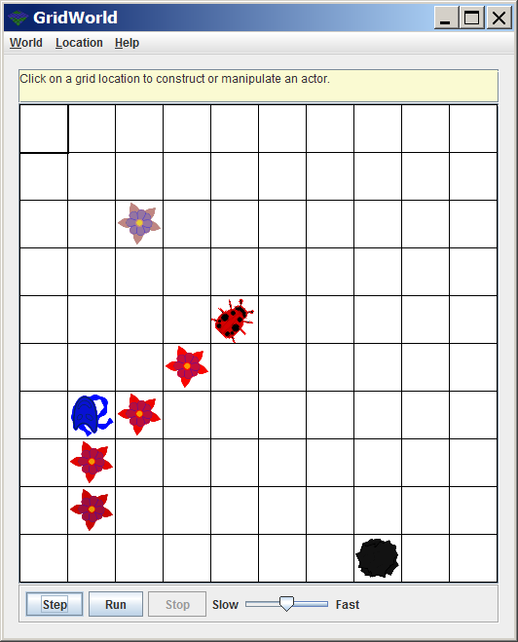
Steps 5 & 6

Slide 74
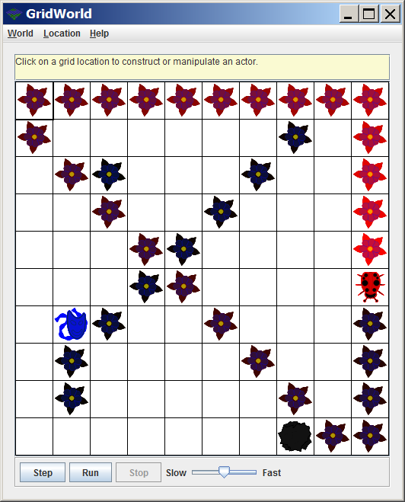
Steps 6 & 40+

